Slide 1
Assembly of the 3D-printed FreiBox components
Assembly overview
Box Plexiglas dimensions

Slide 2
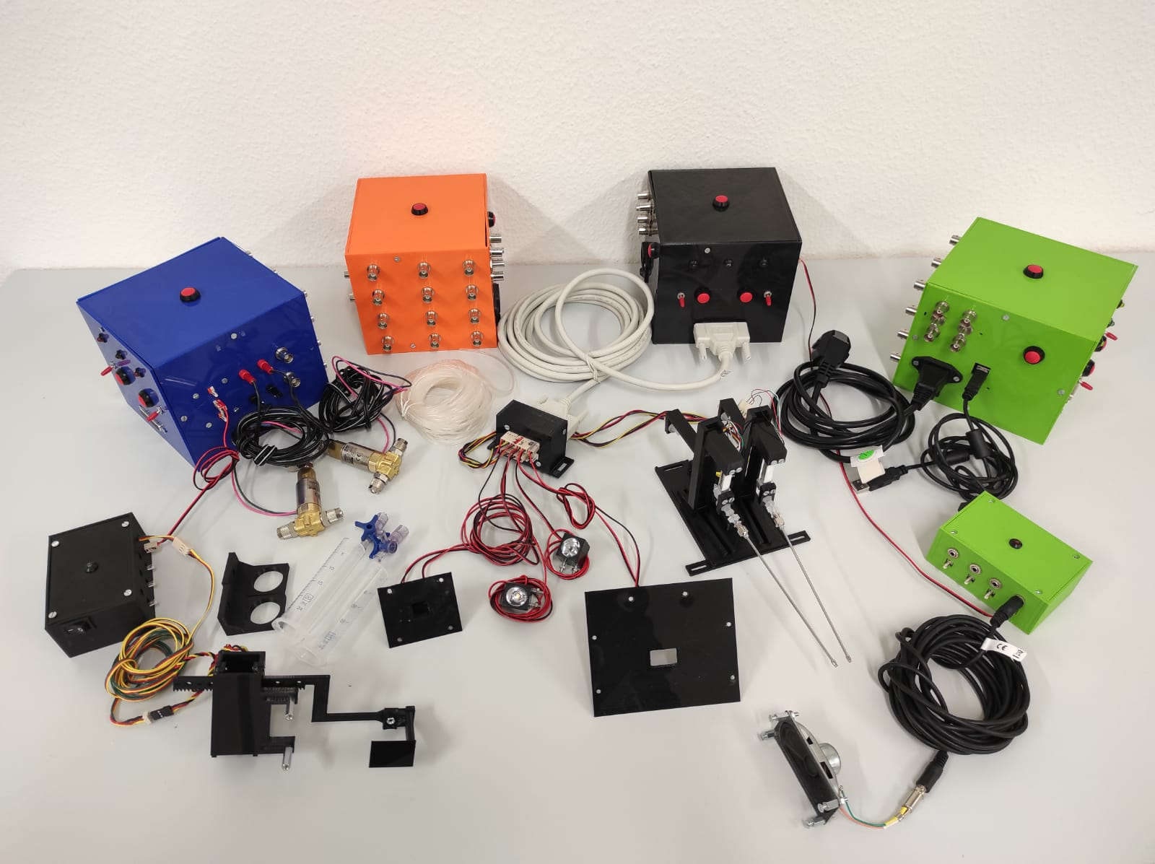
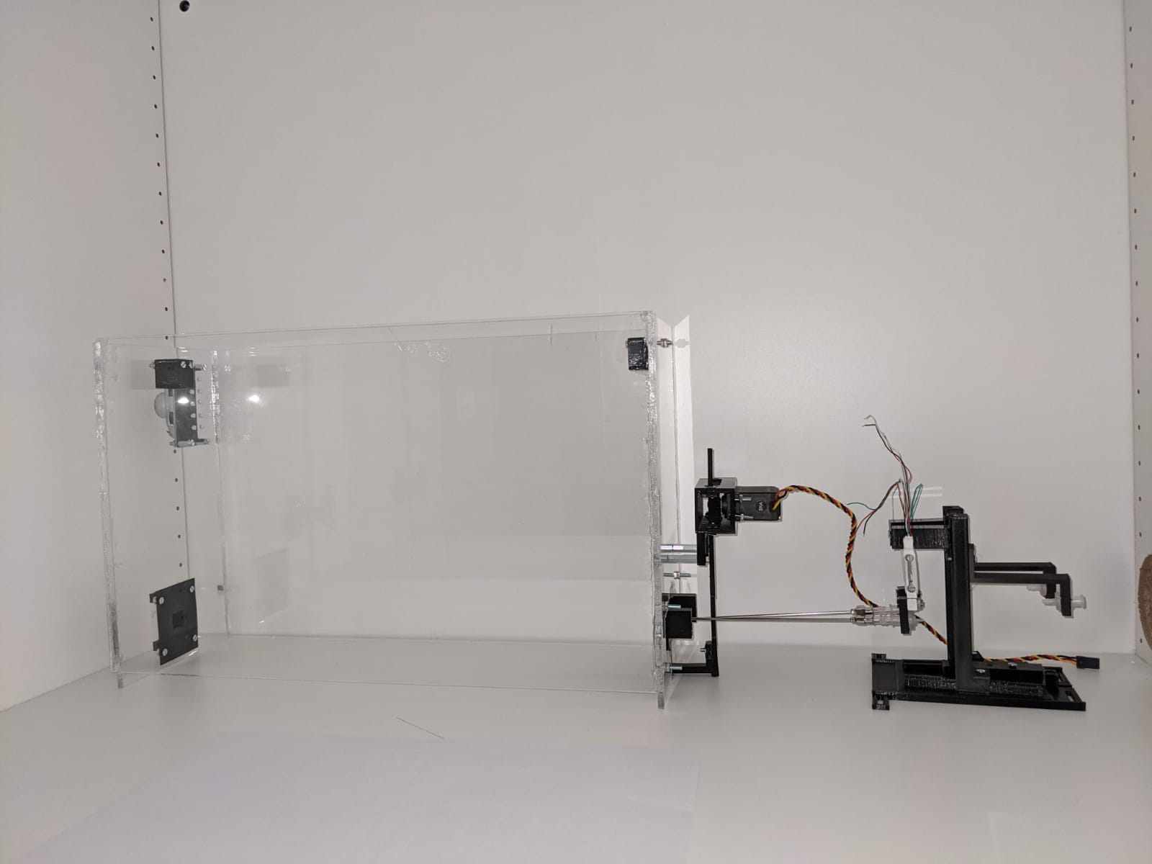
Components Overview

Slide 3
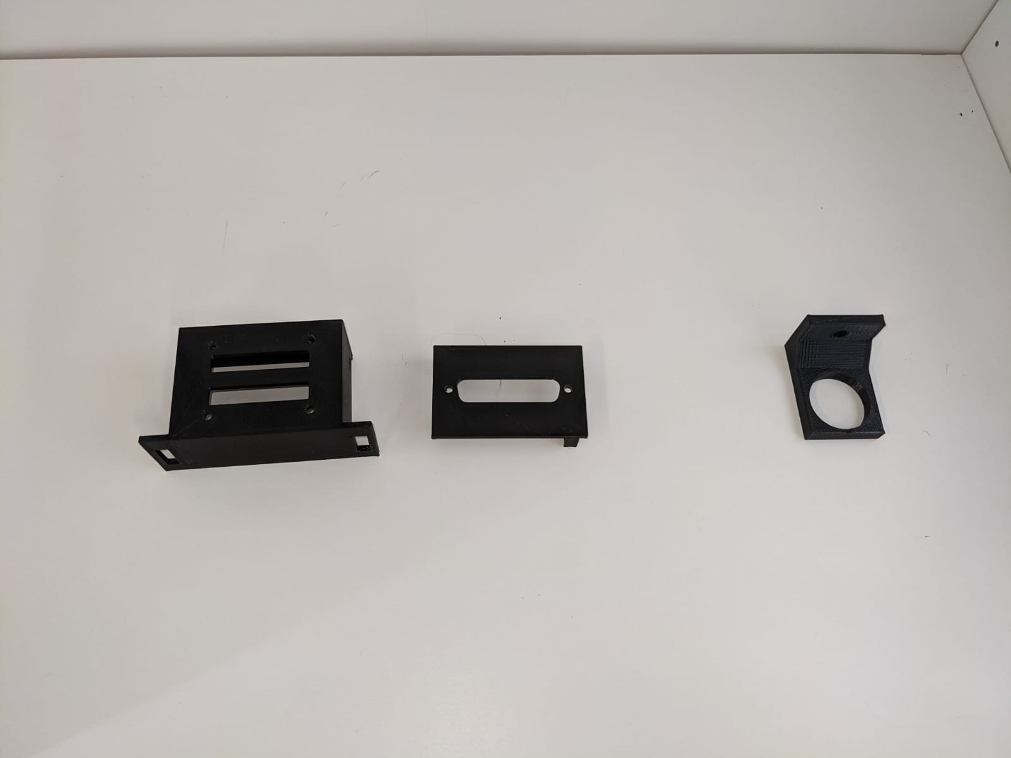
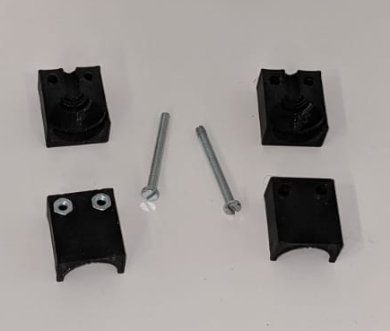
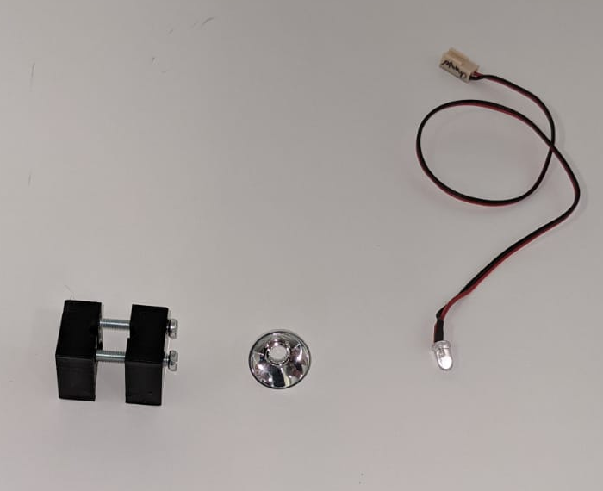
Cable Box + LED holder + Syringe holder
STL file # | STL name
1 | Freibox_InsideBox_FrontPart
2 | Freibox_InsideBox_Rear
3 | Freibox_LEDholder_Part1
4 | Freibox_LEDholder_Part2
18 | Freibox_SyringeHolder
1
2
18
3
For 20mL syringe
ID85
ID41
4
ID37
The front part of the cable box is designed to be used with the perforated board (ID76) in which additional 3mm holes have be drilled in 4 corners/extremities
The rear part is used with the mounted panel D-SUB 25 male plug (ID77)

Slide 4
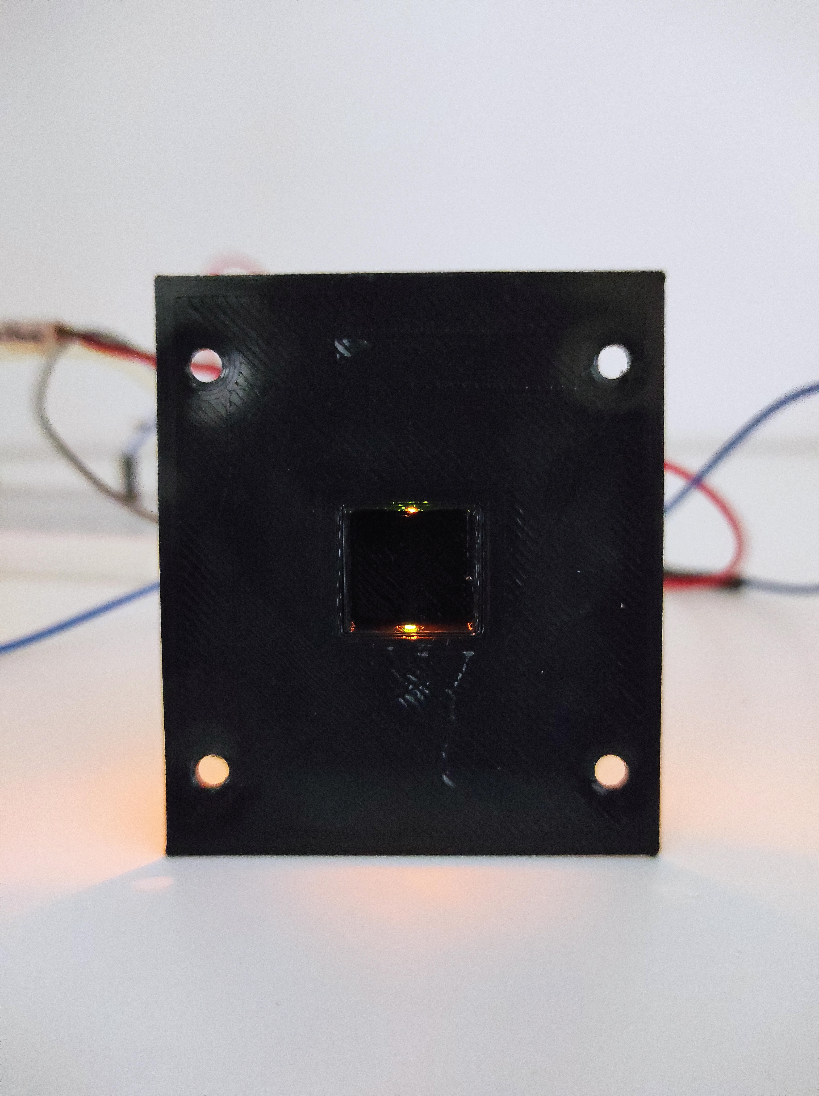
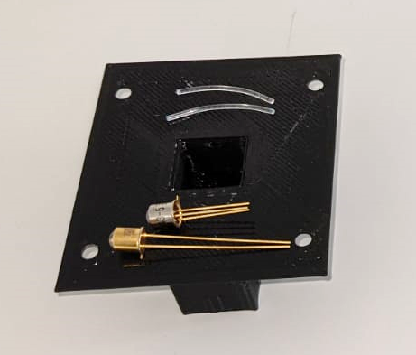
Nose Poke
STL file # | STL name
17 | Freibox_NosePokePort
ID42
ID6
ID5
The bottom part of the LC and NP port are placed 3 cm from the floor

Slide 5
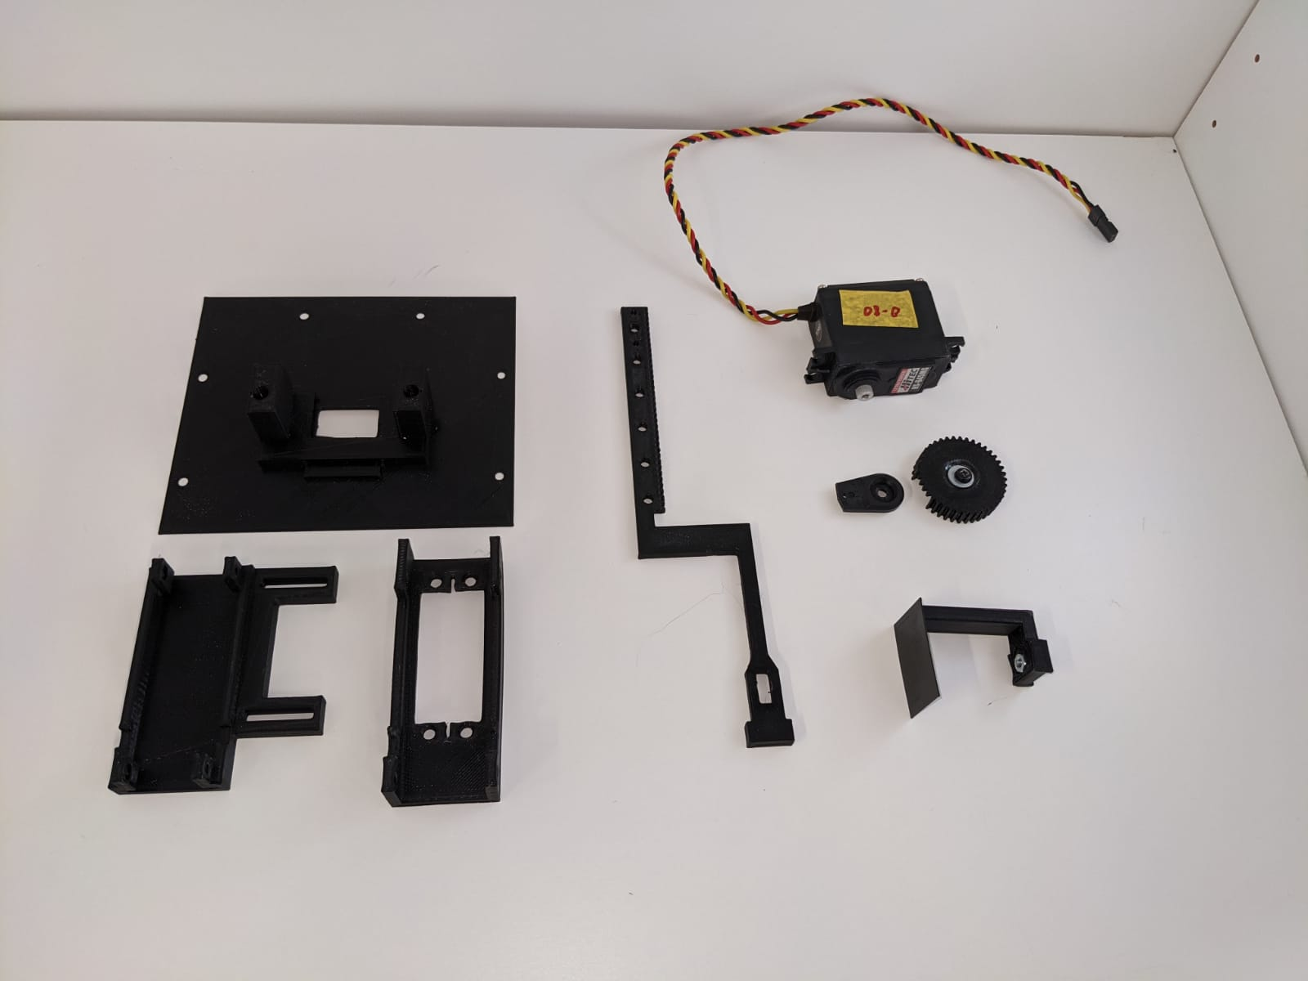
Licking Chamber
STL file # | STL name
5 | Freibox_LickingChamber_MotorGear
6 | Freibox_LickingChamber_gate
7 | Freibox_LickingChamber_gateSlider
8 | Freibox_LickingChamber_LickingChamber
9 | Freibox_LickingChamber_motorHolder_Part1
10 | Freibox_LickingChamber_motorHolder_Part2
8
ID57
7
*
5
9
10
6
* Included in the HS-645MG pack

Slide 6
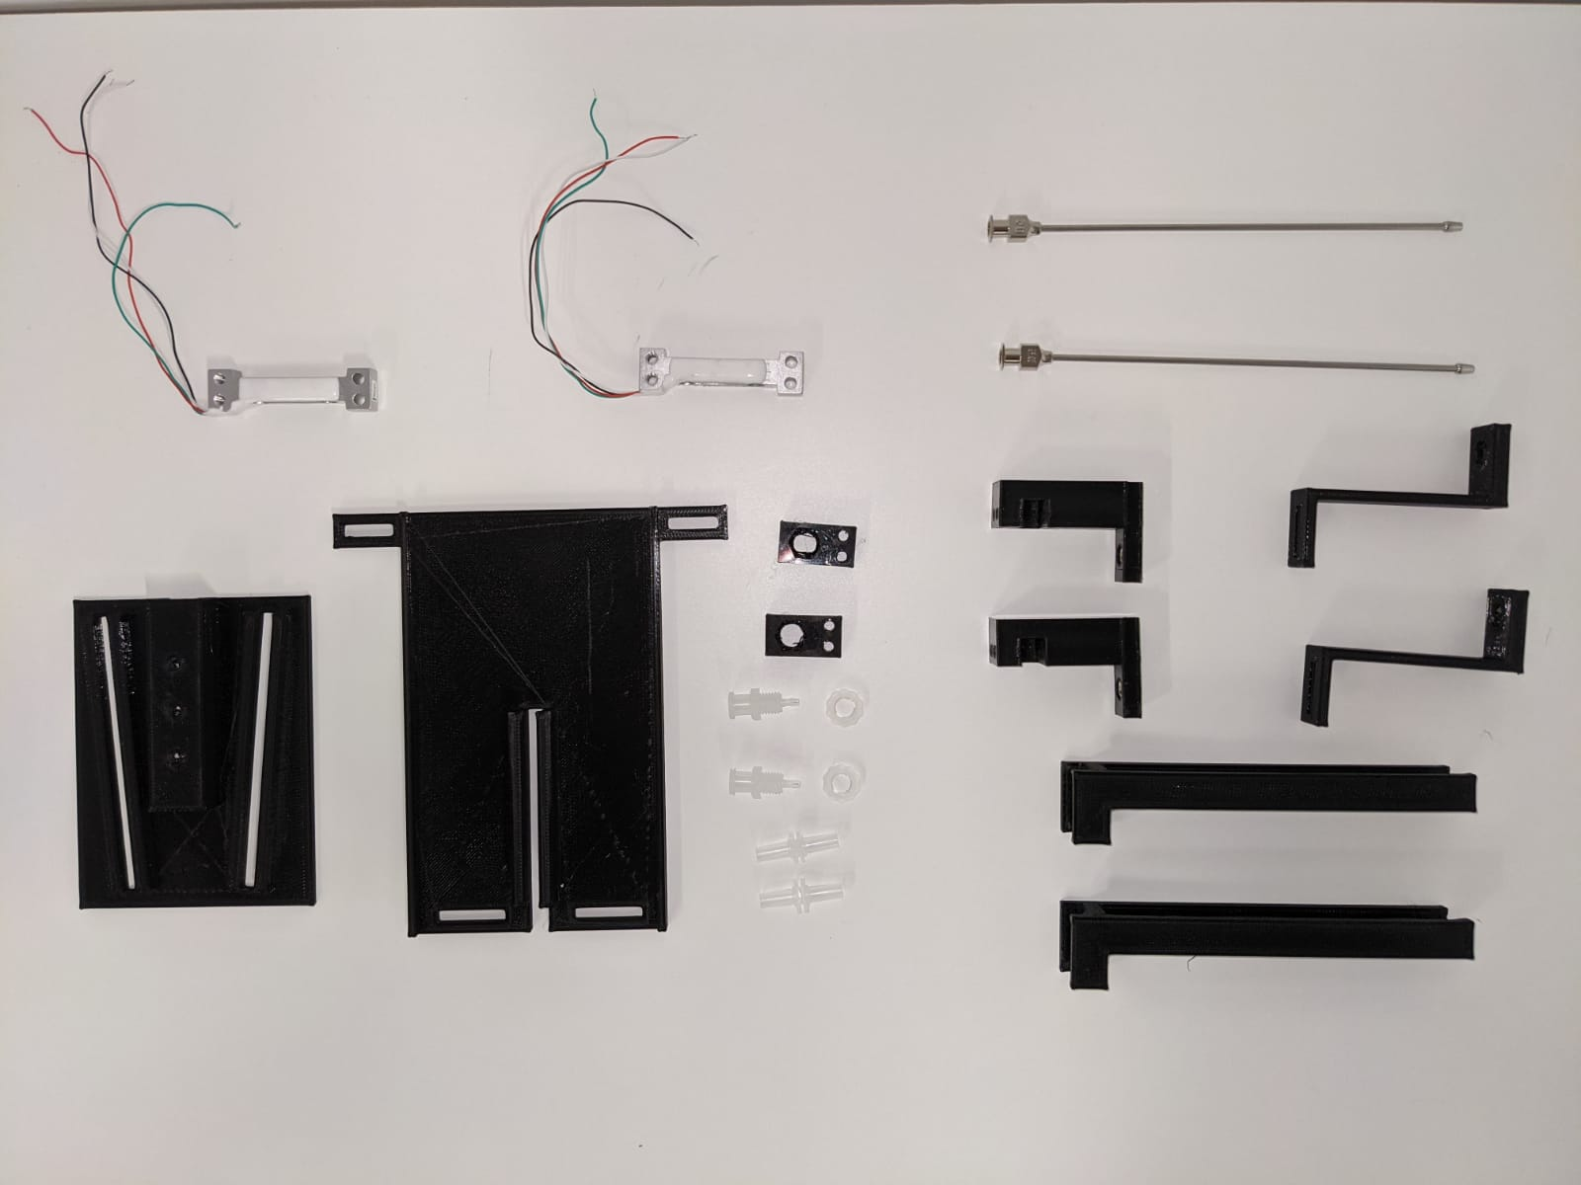
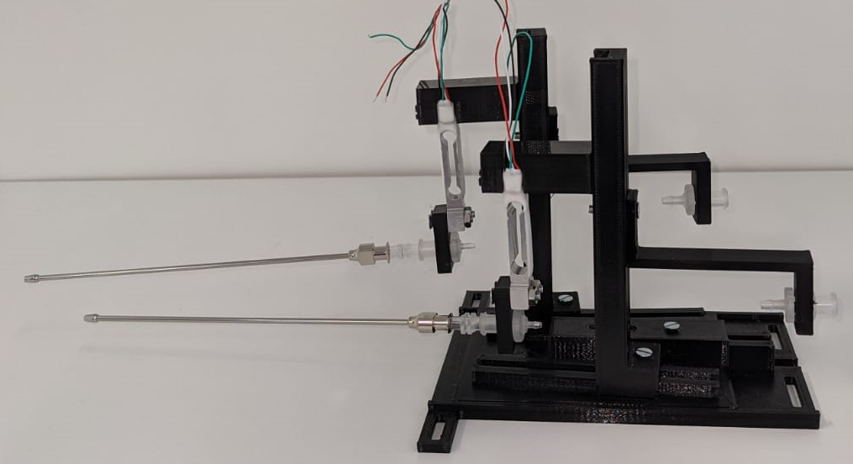
Licking Spout Holder
STL file # | STL name
11 | Freibox_LickingSpoutHolder_lickingSpoutHolder
12 | Freibox_LickingSpoutHolder_pipeSecuringConnector
13 | Freibox_LickingSpoutHolder_Plateforme_Part1
14 | Freibox_LickingSpoutHolder_Plateforme_Part2
15 | Freibox_LickingSpoutHolder_slidingTour
16 | Freibox_LickingSpoutHolder_strainGaugeHolder
ID1
ID43
14
13
11
16
12
ID43
ID44
15

Slide 7
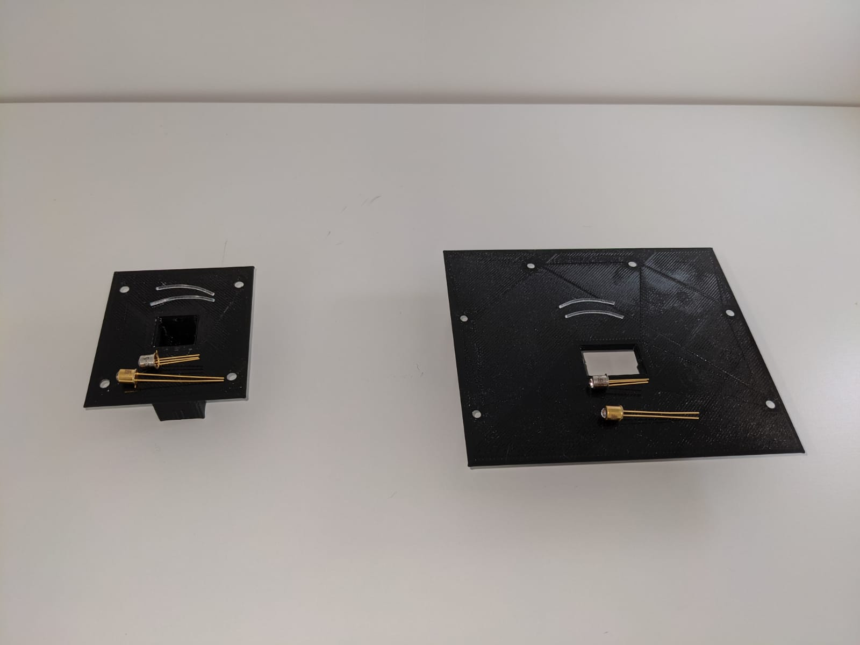
Nose Poke and licking chamber
If the fibres does not fit in their holes, you can increase a bit the size of the slot with a 19 or 18G

Slide 8
3D-printed component list
STL file # | STL name
1 | Freibox_InsideBox_FrontPart
2 | Freibox_InsideBox_Rear
3 | Freibox_LEDholder_Part1
4 | Freibox_LEDholder_Part2
5 | Freibox_LickingChamber_MotorGear
6 | Freibox_LickingChamber_gate
7 | Freibox_LickingChamber_gateSlider
8 | Freibox_LickingChamber_LickingChamber
9 | Freibox_LickingChamber_motorHolder_Part1
10 | Freibox_LickingChamber_motorHolder_Part2
11 | Freibox_LickingSpoutHolder_lickingSpoutHolder
12 | Freibox_LickingSpoutHolder_pipeSecuringConnector
13 | Freibox_LickingSpoutHolder_Plateforme_Part1
14 | Freibox_LickingSpoutHolder_Plateforme_Part2
15 | Freibox_LickingSpoutHolder_slidingTour
16 | Freibox_LickingSpoutHolder_strainGaugeHolder
17 | Freibox_NosePokePort
18 | Freibox_SyringeHolder
19 | Freibox_ArduinoHolder_Part1
20 | Freibox_ArduinoHolder_Part2
21 | Freibox_ElectronicBox_Front
22 | Freibox_ElectronicBox_Ground
23 | Freibox_ElectronicBox_Left
24 | Freibox_ElectronicBox_Rear
25 | Freibox_ElectronicBox_Right
26 | Freibox_ElectronicBox_top
27 | Freibox_AuditoryBox_Part1
28 | Freibox_AuditoryBox_Part2

Slide 9
Box Plexiglas dimensions

Slide 10
Front side (40 x 24 x 0.4 cm)
24 cm
40 cm

Slide 11
Back side (40 x 25 x 0.4 cm)
25 cm
40 cm

Slide 12
Sides (14 x 25 x 0.4 cm)
m
1.5
1.5
1.5
1.1
1.1
6.3
2.3
25 cm
Hole size: 3mm (all holes)
4.5
4.5
5
3
??
1
2.5
4.5 x 2 cm
2
4
5
2.5
3
1.5
1
1
14 cm
14 cm

Slide 13
Bottom (14 x 38.5 x 0.4 cm)
14 cm
38.5 cm

